Slide 1

Digital Differential Analyzer
Fera Putri Ayu Lestari, S.Kom., M.T.
Grafika Komputer – Informatika – UMM

Slide 2
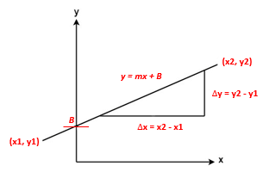
Outline
Line Equation
Cartesian Coordinates
Digital Differential Analyzer (DDA)
Digital Coordinates

Slide 3
1. Line equation
Cartesian Coordinates

Slide 4
Persamaan Garis berdasarkan Koordinat Kartesian
y = mx + B (explicit equation)
m adalah kemiringan garis yang dibentuk oleh dua titik (x1,y1) dan (x2,y2).
Dikatakan persamaan eksplisit karena terdapat simbol m pada rumus tersebut.

Slide 5
Math is all about Substitution
Substitute x = a and y = b in the equation line y = mx + B so that it is obtained:
b = ma + B
then
B = b – ma
Substitute the value of B in the initial equation, y = mx + B so that it is obtained:
y = mx + (b – ma)
y – b = mx – ma
y – b = m(x – a)
So, the equation of the line that passes the point (a, b) with the gradient m is y – b = m(x – a)

Slide 6
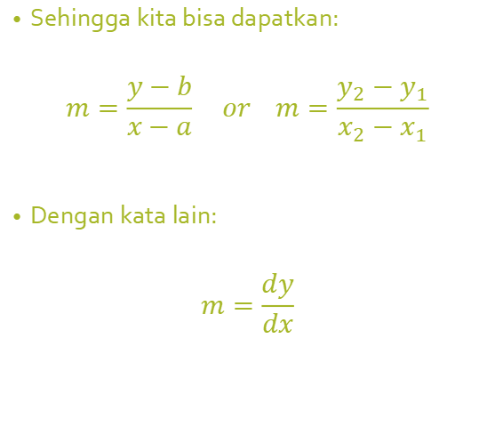
Nilai Gradien m
m adalah kemiringan garis yang dibentuk oleh dua titik (x1,y1) dan (x2,y2)
Dari persamaan sebelumnya
y – b = m(x – a)
Jika kita subtitusikan (x1,y1) dan (x2,y2) ke dalam rumus menjadi:
y2 – y1 = m(x2 – x1)
Sehingga kita bisa dapatkan:
$$m=\frac{y−b}{x−a} or m=\frac{y_{2}−y_{1}}{x_{2}−x_{1}}$$
Dengan kata lain:
$$m=\frac{dy}{dx}$$

Slide 7
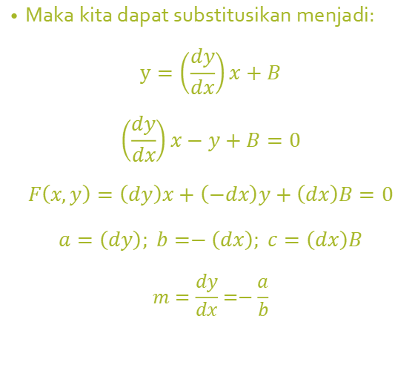
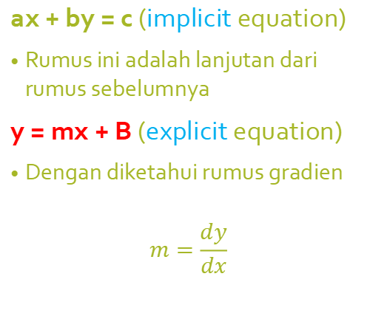
Persamaan Garis lain (implicit equation)
ax + by = c (implicit equation)
Rumus ini adalah lanjutan dari rumus sebelumnya
y = mx + B (explicit equation)
Dengan diketahui rumus gradien
$$m=\frac{dy}{dx}$$
Maka kita dapat substitusikan menjadi:
$$y=\left(\frac{dy}{dx}\right)x+B$$
$$\left(\frac{dy}{dx}\right)x−y+B=0$$
$$F\left(x,y\right)=\left(dy\right)x+\left(−dx\right)y+\left(dx\right)B=0$$
$$a=\left(dy\right); b=−\left(dx\right); c=\left(dx\right)B$$
$$m=\frac{dy}{dx}=−\frac{a}{b}$$

Slide 8
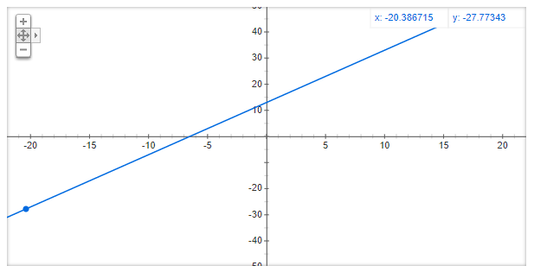
Example 1: Determine the equation of the line through point (-4, 5) with gradient 2!
Answer:
a = –4;
b = 5;
m = 2
y - b = m (x - a) ⇔ y - 5 = 2 (x - (-4))
⇔ y - 5 = 2 (x + 4)
⇔ y - 5 = 2x + 8
⇔ y = 2x + 13

Slide 9
How to Draw Lines
X | Y
0 | 13
1 | 15
2 | 17
3 | 19
… | …
7 | 27
At the equation
y = 2x + 13,
if we choose x = 0, we get y = 13.
if we choose y = 0, we get x = –6.5.
So the equation of the line goes through points (0, 13) and (-6.5, 0).

Slide 10
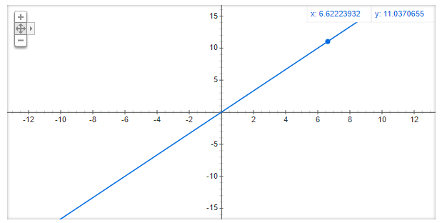
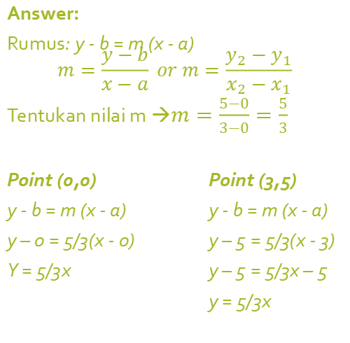
Example 2: Determine the equation of the line through the center (0, 0) and point (3, 5)!
Answer:
Rumus: y - b = m (x - a)
$$m=\frac{y−b}{x−a} or m=\frac{y_{2}−y_{1}}{x_{2}−x_{1}}$$
Tentukan nilai m →$m=\frac{5−0}{3−0}=\frac{5}{3}$
Point (0,0) Point (3,5)
y - b = m (x - a) y - b = m (x - a)
y – 0 = 5/3(x - 0) y – 5 = 5/3(x - 3)
Y = 5/3x y – 5 = 5/3x – 5
y = 5/3x

Slide 11
exercise
Determine the equation of the line through points

Slide 12
Exercise
Determine the equation of the line through points (3, 5) and (-2, 4)!
Determine the equation of the line through points (-4, 2) and (5, 2)!

Slide 13
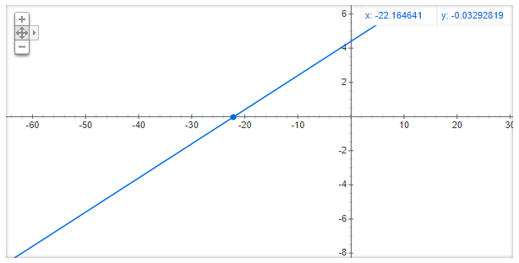
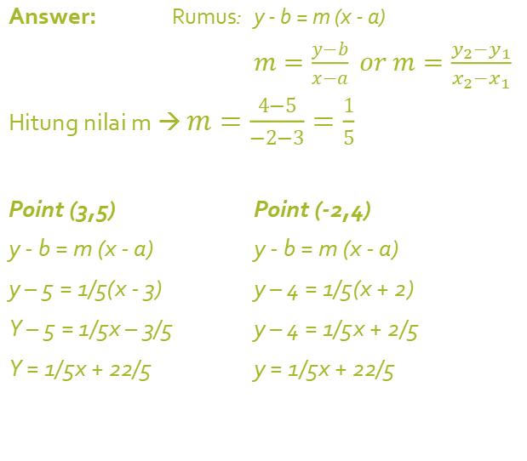
Answer no. 1 Determine the equation of the line through points (3, 5) and (-2, 4)!
Answer: Rumus: y - b = m (x - a)
$m=\frac{y−b}{x−a} or m=\frac{y_{2}−y_{1}}{x_{2}−x_{1}}$
Hitung nilai m → $m=\frac{4−5}{−2−3}=\frac{1}{5}$
Point (3,5) Point (-2,4)
y - b = m (x - a) y - b = m (x - a)
y – 5 = 1/5(x - 3) y – 4 = 1/5(x + 2)
Y – 5 = 1/5x – 3/5 y – 4 = 1/5x + 2/5
Y = 1/5x + 22/5 y = 1/5x + 22/5

Slide 14
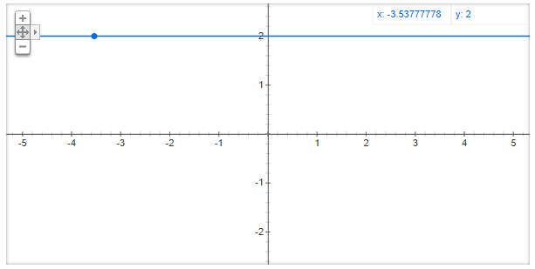
Answer no. 2 Determine the equation of the line through points (-4, 2) and (5, 2)!
Answer:
Rumus: y2 – y1 = m(x2 – x1)
2 – 2 = m(5-(-4))
0 = m (5+4)
m = 0/9 = 0
Point (-4,2) Point (5,2)
y - b = m (x - a) y - b = m (x - a)
y – 2 = 0(x + 4) y – 2 = 0(x - 5)
Y = 2 y = 2

Slide 15
Garis yang Saling Tegak Lurus
Perpendicular Line

Slide 16
Garis yang Saling Tegak Lurus
Perpendicular Line
The gradient of two lines perpendicular to each other if multiplied by the result is equal to -1
Dikatakan tegak lurus jika hasil kali nilai gradien nya sama dengan -1
So, if line “a” is perpendicular to line “b” then it applies m_{a} × m_{b} = –1

Slide 17
Example 1
The line “k” has the equation y = 2x + 5. If line “l” is perpendicular to line “k”, determine the gradient of line “l” !
Answer:
mk = 2 mk × ml = - 1
2 x ml = - 1 ml = - 1/2
So, the line gradient of “l” is – 1/2

Slide 18
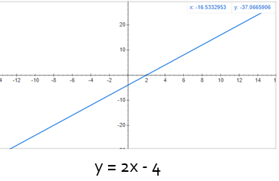
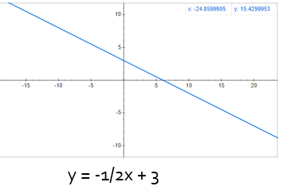
Example 2
Determine the equation of the line through the point (-2, 4) and perpendicular to the line y = 2x - 4!
Answer:
The gradient line y = 2x - 4 is m = 2
y - b = -1/m (x - a) ⇔ y - 4 = -1/2 (x - (-2))
⇔ y - 4 = -1/2x -1
⇔ y = -1/2x + 3

Slide 19
2. Digital Differential Analyzer (DDA)
An Algorithm to Draw Line in Digital Coordinates

Slide 20
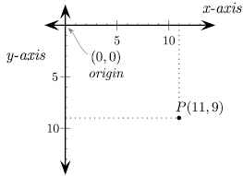
Digital Coordinate
For using graphics functions, output screen system is treated as a coordinate system where the coordinate of the top-left corner is (0, 0) and as we move down our x-ordinate increases and as we move right our y-ordinate increases for any point (x, y).

Slide 21
Draw Line in Computer Graphics
In any 2-Dimensional plane if we connect two points (x0, y0) and (x1, y1), we get a line segment using cartesian coordinate.
But in the case of computer graphics (raster) we can not directly join any two coordinate points,
for that we should calculate intermediate point’s coordinate and put a pixel for each intermediate point, of the desired color with help of functions
like put pixel (x, y, K) in C, where (x, y) is our co-ordinate and K denotes color and C is a canvas.

Slide 22
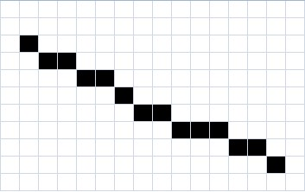
“Good” Discrete Line
No gaps in adjacent pixels
Pixels close to ideal line
Consistent choices; same pixels in same situations
Smooth looking
Lines should have constant density
Same line for P₀P₁ as for P₁P₀
P₀ = start point, P₁ = end point

Slide 23
Intermediate point’s
8
7
6 | (0,6) |  |  |  |  |  | (6,6)
5
4
3
2 | (0,2) |  | (2,2)
1
0
 | 0 | 1 | 2 | 3 | 4 | 5 | 6 | 7
Input: For line segment between (2, 2) and (6, 6) ;
we need (3, 3) (4, 4) and (5, 5) as our intermediate points.
Input: For line segment between (0, 2) and (0, 6) ;
we need (0, 3) (0, 4) and (0, 5) as our intermediate points.
Active Pixel (Intermediate Points)

Slide 24
Intermediate point’s
9
8
7
6
5
4
3
2
1
0 | 1 | 2 | 3 | 4 | 5 | 6 | 7 | 8 | 9
How about this →
For line segment between (1,1) and (8,7)
Where are our intermediate points?
How do we determined it?
(8,7)
?
(1,1)
Active Pixel (Intermediate Points)

Slide 25
Digital Differential Analyzer (DDA)
DDA is a line formation algorithm based on the calculation of ∆x and ∆y, using the formula
∆y = m ∆x
The line is created by specifying two endpoints, namely starting point and end point.

Slide 26
Steps for formation according to the DDA algorithm:
Determine the two points that will be connected.
Determine one point as the starting point (x0, y0) and end point (x1, y1).
Calculate: ∆x = x1 – x0, and ∆y = y1 – y0.
Determine the “step”, which is the maximum of the |∆x| or |∆y|.
If the value of |∆y| > |∆x|, then “step” = |∆y|
If not then “step” = |∆x|
Calculate pixel coordinates, x_increment = ∆x / step and y_increment = ∆y / step.
The next coordinate is (x + x_increment, y + y_increment).
The pixel position at the layer is determined by rounding the coordination value.
Repeat steps 6 and 7 to determine the next pixel position, until x = x1 and y = y1.

Slide 27
Implementation
Step 1-2
To describe the DDA algorithm in the formation of a line connect the dots A(10, 10) and B(17, 16).
Where A as starting point and B as end point.
Step 3 (determine dx and dy)
∆x = x1 – x0 = 17 – 10 = 7 → |∆x| = 7
∆y = y1 – y0 = 16 – 10 = 6 → |∆y| = 6
Step 4 (look for steps )
Because |∆x| > |∆y| is fulfilled, then “step” is |∆x| = 7
Step 5 (get x_increment and y_increment)
x_increment = ∆x / step = 7/7 = 1
y_increment = ∆y / step = 6/7 = 0,86

Slide 28
Next implementation [A(10, 10) and B(17, 16)]
Step 6-7
x + x_increment → 10 + 1 = 11
y + y_increment → 10 + 0,86 = 10,86 = 11
Step 8 (repeat from step 6-7)
x + x_increment → 11 + 1 = 12
y + y_increment → 10,86 + 0,86 = 11,72 = 12
until x = x1(17) and y = y1(16)
As the result :
k | x | y | Round(x), Round(y)
 |  |  | (10,10)
0 | 11 | 10.86 | (11,11)
1 | 12 | 11.72 | (12,12)
2 | 13 | 12.58 | (13,13)
3 | 14 | 13.44 | (14,13)
4 | 15 | 14.3 | (15,14)
5 | 16 | 15.16 | (16,15)
6 | 17 | 16.02 | (17,16)

Slide 29
Then draw it →
18
17
16
15
14
13
12
11
10
 | 10 | 11 | 12 | 13 | 14 | 15 | 16 | 17 | 18
k | x | y | Round(x), Round(y)
 |  |  | (10,10)
0 | 11 | 10.86 | (11,11)
1 | 12 | 11.72 | (12,12)
2 | 13 | 12.58 | (13,13)
3 | 14 | 13.44 | (14,13)
4 | 15 | 14.3 | (15,14)
5 | 16 | 15.16 | (16,15)
6 | 17 | 16.02 | (17,16)

Slide 30
Advantages of DDA algorithm
It is a faster method than method of using direct use of line equation.
This method does not use multiplication theorem.
It allows us to detect the change in the value of x and y ,so plotting of same point twice is not possible.
This method gives overflow indication when a point is repositioned.
It is an easy method because each step involves just two additions.

Slide 31
Disadvantages of DDA algorithm
Floating point arithmetic in DDA algorithm is still time consuming.
The algorithm is orientation dependent. Hence end point accuracy is poor.
Although DDA is fast, the accumulation of round-off error in successive additions of floating point increment, however can cause the calculation pixel position to drift away from the true line path for long line segment.

Slide 32
THANKYOU
Tugas next to you

Slide 33
TASK
Draw a straight line through the points specified in class:
using the equation of a straight line
using the Digital Differential Analyser (DDA) algorithm!
Complete the task following the steps shown on slides 26–29.
Handwritten in pencil on graph paper
To be handed in at the next class session

Slide 34
Tugas
Buat sebuah garis lurus dari titik-titik yang telah ditentukan di kelas:
menggunakan rumus persamaan garis
menggunakan algoritma Digital Differential Analyzer (DDA)!
Kerjakan sesuai urutan step seperti pada slide 26-29.
Ditulis tangan pakai pensil di folio garis
Dikumpulkan pada pertemuan berikutnya di kelas

